Slide 1
Image Search Engine
A Website Project for Searching and Downloading Images

Slide 2
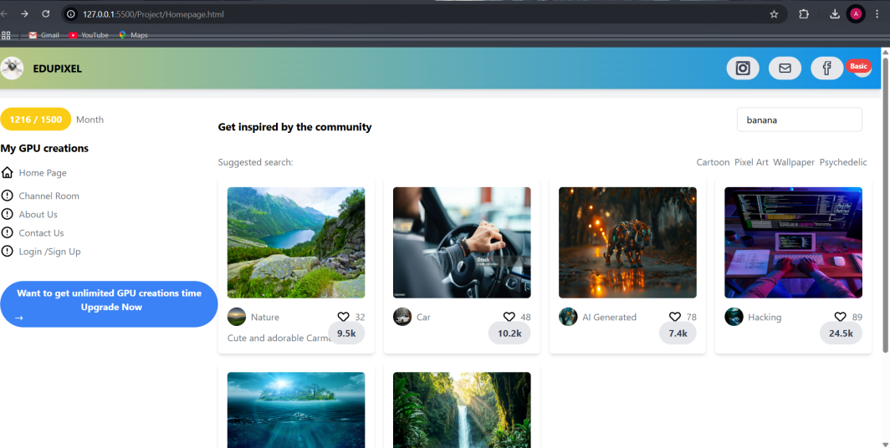
Introduction
The Image Search Engine is a web-based platform that allows users to search and download images based on their preferences.

Slide 3
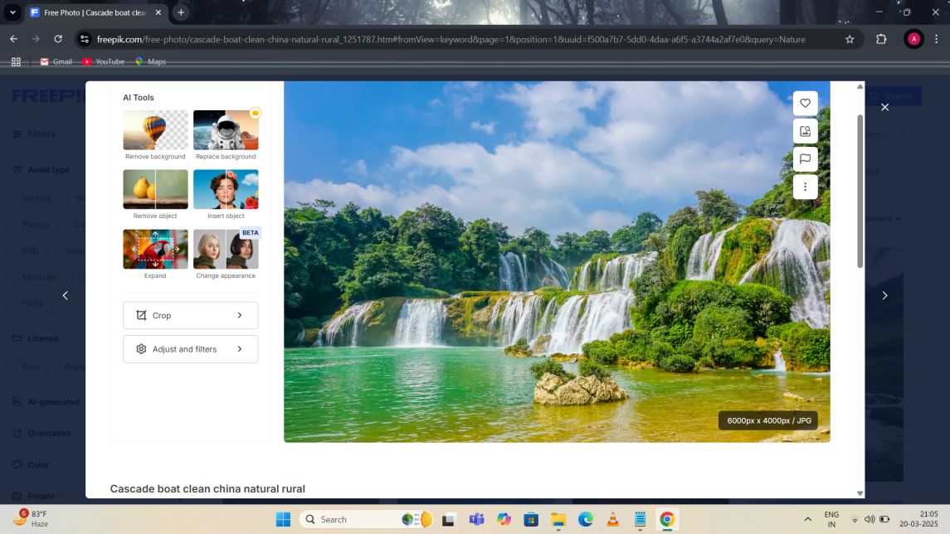
Objective
To create an efficient and user-friendly image search engine that enables users to find high-quality images quickly and easily.

Slide 4
Features
- Advanced Image Search
- Image Filtering Options
- Download Functionality
- User-friendly Interface

Slide 5

Technologies Used
- HTML, CSS, JavaScript for Frontend
- API Integration for Image Retrieval

Slide 6
How It Works
1. User enters a search query.
2. The system fetches relevant images from the database or external API.
3. The user can apply filters and select images.
4. The selected images can be downloaded.

Slide 7

User Interface
A clean and responsive design ensuring easy navigation and accessibility.

Slide 8

Search Functionality
Users can search images using
keywords and apply various filters
like resolution, format, and category.

Slide 9
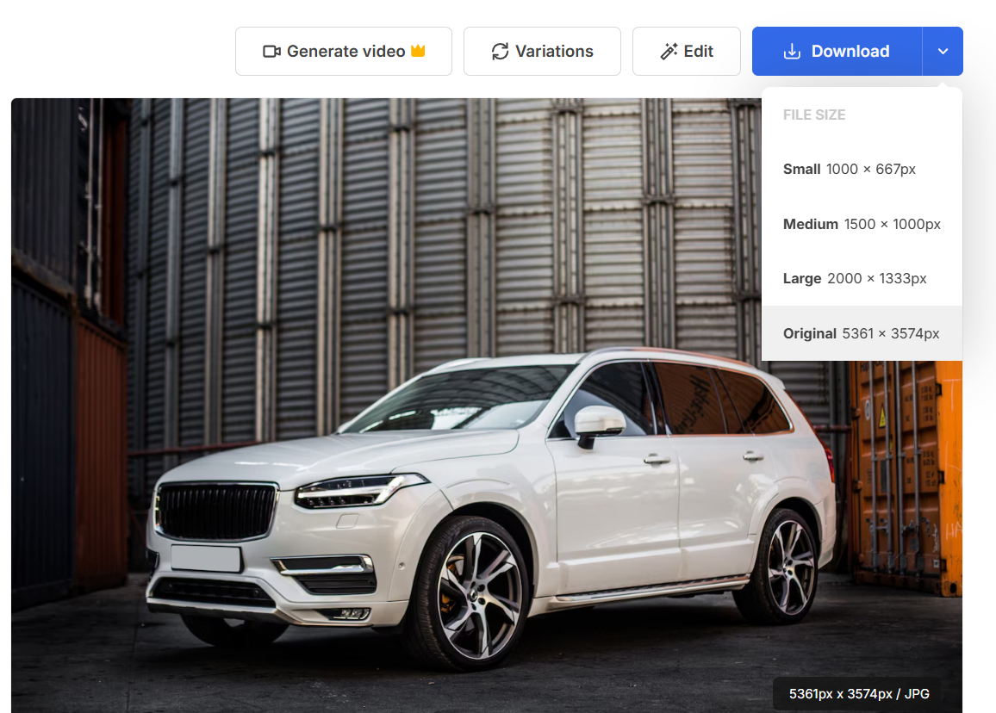
Image Downloading
Users can easily download images in multiple resolutions and formats.

Slide 10
Challenges Faced
- Ensuring fast search results
- Managing copyright issues
- Maintaining a large image database

Slide 11
Future Enhancements
- AI-based image recommendations.
- Improved filtering options
- Integration with cloud storage

Slide 12
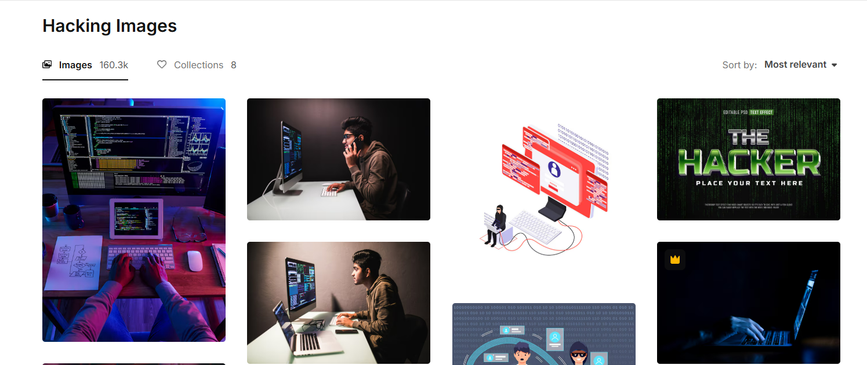
Conclusion
The Image Search Engine is an efficient and valuable tool for users seeking high-quality images with ease.

Slide 13
Thank You!
Questions? Feel free to ask.

